Slide 1
4.3Phishing

Slide 2


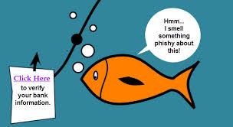

Slide 3
How Phishing Works?
1.Planning :
Decide the target
Determine how to get e-mail address of the target
(Usually Phishers use mass mailing)
2.Setup
Create methods for delivering the message/mail and collect the data about the target
This involves creating e-mail addresses and/or webpages

Slide 4
How Phishing Works?
3.Attack :
Send a phony message/e-mail that appears to be from reputable source
4.Collection
Phishers record the information of victims entering into webpages or pop-up windows
5.ID Theft and Fraud
Phishers use the information gathered in Phishing to make illegal
purchases or commercial fraud,ID theft,e-mail spoofing

Slide 5
How to recognize a Phishing Attack?
1. Legit companies don’t request your sensitive information via email
Chances are if you receive an unsolicited email from an institution that provides a link or attachment and asks you to provide
sensitive information, it’s a scam. Most companies will not send you an email asking for passwords, credit card information,
credit scores, or tax numbers, nor will they send you a link from which you need to login.

Slide 6
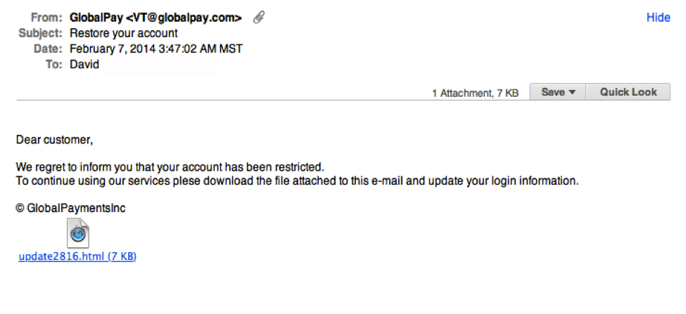
Example

Slide 7
How to recognize a Phishing Attack?
2. Legit companies usually call you by your name
Phishing emails typically use generic salutations such as “Dear valued member,” “Dear account holder,” or “Dear customer.”
If a company you deal with required information about your account, the email would call you by name and probably direct you to contact them via phone.
BUT, some hackers simply avoid the salutation altogether. This is especially common with advertisements.

Slide 8
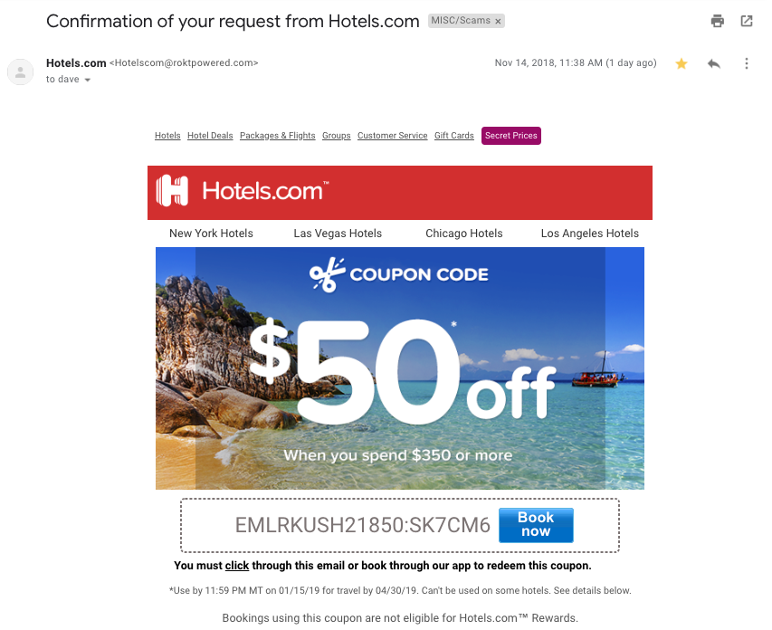
Example

Slide 9
How to recognize a Phishing Attack?
3. Legit companies have domain emails
Don’t just check the name of the person sending you the email. Check their email address by hovering your mouse over the ‘from’ address. Make sure no alterations (like additional numbers or letters) have been made. Check out the difference between these two email addresses as an example of altered emails: michelle@paypal.com michelle@paypal23.com

Slide 10

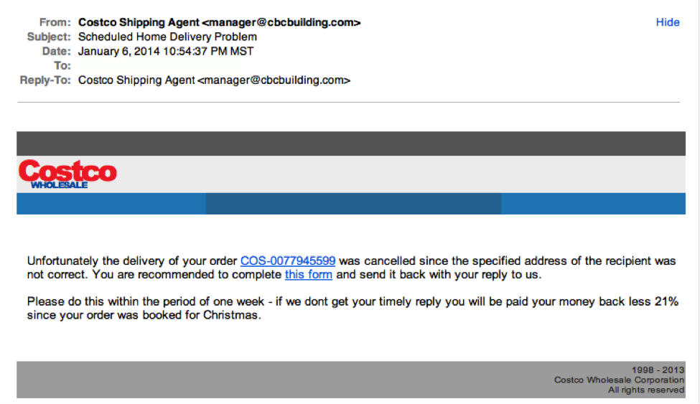
Example

Slide 11
How to recognize a Phishing Attack?
4. Legit companies know how to spell
Possibly the easiest way to recognize a scammy email is bad grammar. An email from a legitimate organization should be well written. Little known fact – there’s actually a purpose behind bad syntax. Hackers generally aren’t stupid. They prey on the uneducated believing them to be less observant and thus, easier targets.

Slide 12
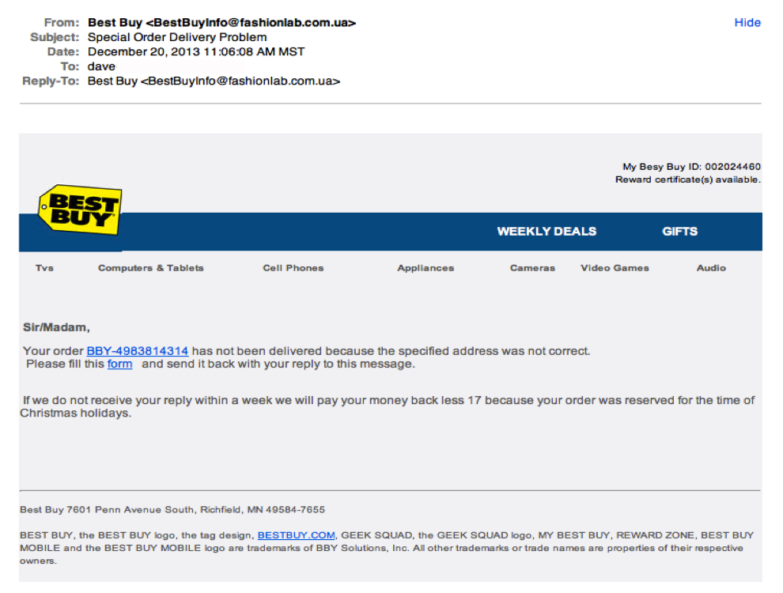
Example

Slide 13
How to recognize a Phishing Attack?
5. Legit companies don’t force you to their website
Sometimes phishing emails are coded entirely as a hyperlink. Therefore, clicking accidentally or deliberately anywhere in the email will open a fake web page, or download spam onto your computer.

Slide 14
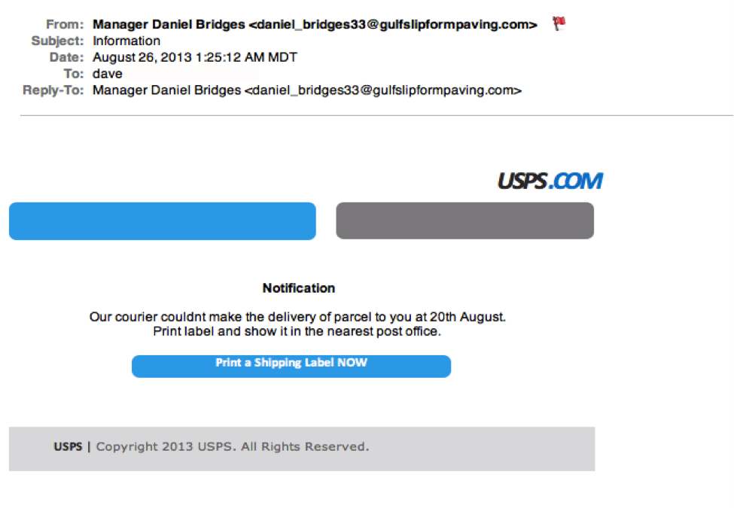
Example

Slide 15
How to recognize a Phishing Attack?
6. Legit companies don’t send unsolicited attachments
Unsolicited emails that contain attachments reek of hackers. Typically, authentic institutions don’t randomly send you emails with attachments, but instead direct you to download documents or files on their own website.
Like the tips above, this method isn’t foolproof. Sometimes companies that already have your email will send you information, such as a white paper, that may require a download. In that case, be on the lookout for high-risk attachment file types include .exe, .scr, and .zip. (When in doubt, contact the company directly using contact information obtained from their actual website.)

Slide 16
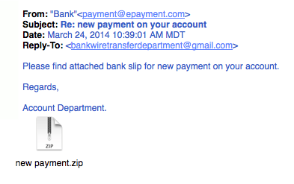
Example

Slide 17
4.4 Password Cracking

Slide 18
What is Password ?
A key to get an entry into computerized systems

Slide 19
What is Password ?
A key to get an entry into computerized systems
What is Password Cracking?
A process of recovering passwords from data that have been stored in or
transmitted by a computer system
Usually,a common approach of guessing the passwords is used

Slide 20
What is Password ?
A key to get an entry into computerized systems
What is Password Cracking?
A process of recovering passwords from data that have been stored in or
transmitted by a computer system
Usually,a common approach of guessing the passwords is used
Purpose of Password Cracking

Slide 21
What is Password ?
A key to get an entry into computerized systems
What is Password Cracking?
A process of recovering passwords from data that have been stored in or
transmitted by a computer system
Usually,a common approach of guessing the passwords is used
Purpose of Password Cracking
To recover a forgotten password

Slide 22
What is Password ?
A key to get an entry into computerized systems
What is Password Cracking?
A process of recovering passwords from data that have been stored in or
transmitted by a computer system
Usually,a common approach of guessing the passwords is used
Purpose of Password Cracking
To recover a forgotten password
As a preventive measure by system administrators to check for crackability of
Passwords
To gain unauthorized access to a system

Slide 23
Manual Password Cracking
An attempt to logon with different passwords
Steps followed :
1.Find a valid user account such as an Administrator or Guest
2.Create a list of possible passwords
3.Rank the passwords from high to low probability
4.Key-in each password
5.Try until a successful password is found

Slide 24
Password guessing
Passwords can be guessed sometimes with knowledge of the user’s Personal
information
Examples of guessable passwords include :
1.Words like “password”,”passcode”,”admin”
2.Series of letters “QWERTY”,”qwertyuiop”,”asdf”
3.User name
4.Name of close friend,spouse,close person,pet
5.Birthplace,DOB(Own/close person)
6.Vehicle number,office number,residence number,mobile number
7.Name of idol(actor,spritual guru)
8.Favourite God name

Slide 25
Password guessing
The attacker can also create a script file/automated program which will be
executed to try each password in a list.
This is still considered manual cracking
It is time consuming and less effective

Slide 26
How Password Authentication is done by the system?
Passwords are stored in a database
A password verification process is established into a system when a system user attempts to login or access a restricted source
To ensure Confidentiality of a password,password verification data is not stored in a clear text format
e.g.
One-way function(encryption function or cryptographic hash) is applied to the password and resulting value is stored in the database
When user tries to login the system by entering password,one way function is applied to entered password,result is compared with stored value.If they match,then only user gains the access
This is called as Password Authentication

Slide 27
Vulnerability threat in spite of Password Authentication
Even though passwords are cryptographically secure Attacker attempts to get possession of hashed password
attacker then uses Password Cracking tools to get the original text password

Slide 28
Password Cracking Tools
1.www.defaultpassword.com : Default paswords
Usually,network devices such as switches,hubs and routers are equipped with default passwords and these passwords are not changed after connecting these devices into the network
Attackers can get the access to these default passwrods by visiting above website

Slide 29
Password Cracking Tools
2.http://www.oxid.it/cain/html : Cain and Abel
Typically used for Microsoft OS
Allows to crack password by sniffing the network,cracking
encrypted passwords using dictionary,brute force attacks,decoding
scrambled passwords

Slide 30
Password Cracking Tools
3.www.openwall.com/john : John the Ripper
Free and open source software
Fast password cracker compatible with many OS
Primary purpose : To detect weak UNIX passwords

Slide 31
Password Cracking Tools
4.www.freeworld.thc.org/thc-hydra
Very fast network logon cracker which supports many services
5.www.l0phtcrack.com : L0phtCrack
Used to crack Window passwords from hashes which it obtains from
Windows workstations,networked servers
It also has numerous methods of generating password guesses

Slide 32
Password Cracking Tools
6.www.airsnort.shmoo.com : AirSnort
Wireless LAN tool which recovers encryption keys
Operates by passively monitoring transmissions,computing the
encryption key when packets are sent
Can guess the encryption password in under a second
Runs under Windows or Linux

Slide 33
Classification of Password Cracking Attacks
Non-electronic attacks
Online attacks
Offline attacks

Slide 34
Classification of Password Cracking Attacks
Non-electronic attacks(Social Engg,Shoulder Surfing,Dumpster Diving)
Online attacks
Offline attacks

Slide 35
Classification of Password Cracking Attacks
Online Attacks
An attacker can create a script file that will be executed to try each password in a list and allows access to attacker when match takes place
MITM(Man In The Middle) Attack(Bucket Brigade Attack or Janus Attack)
Form of Active Eavesdropping
Attacker establishes a connection between a victim and a server to which victim is connected
When a victim tries to connect to his server,MITM server intercepts the call,extracts the password while it sends the hashed password to the victim’s server
Used to access passwords for e-mail accounts on public websites such as Yahoo,Gmail,Facebook,etc and financial websites

Slide 36
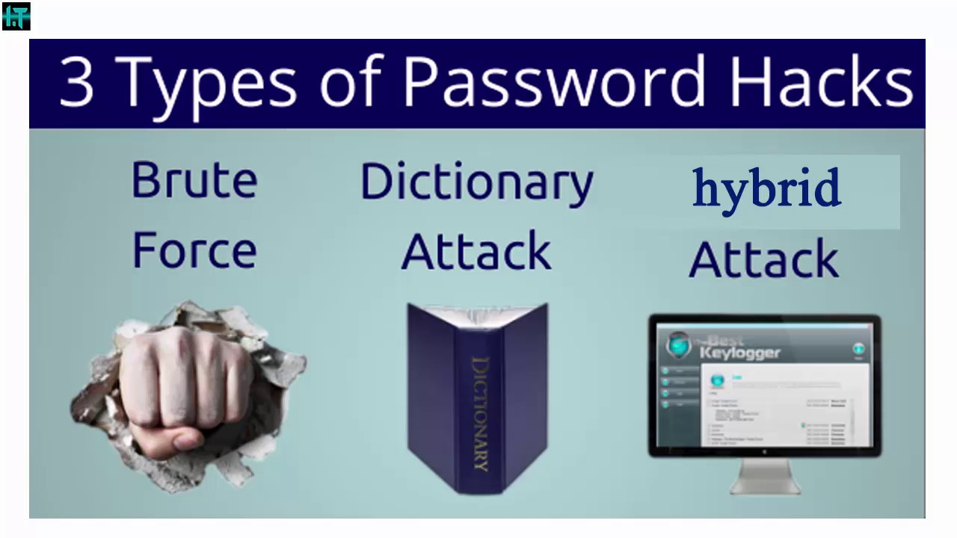
Classification of Password Cracking Attacks
Offline Attacks
Require physical access to computer

Slide 37
Classification of Password Cracking Attacks
Offline Attacks
Brute Force Attack
Attempts all possible permutations-combinations of letters,numbers,special characters
e.g.Adm!n@09
Dictionary Attack
Attempts to match all the words from the dictionary to get the password
e.g.Administrator
Hybrid Attack
Substitutes numbers and symbols to get the password
e.g.Adm1n1strator

Slide 38
Strong,Weak Passwords
Weak Passwords
Easily guessed
short
common
easily found by Brute Force attack and/or dictionary attack
Examples
1.Common personal names
2.repeated letters can be guessed : aaa
3.common pet names : rocky
4.abc123,1234,admin : can be easily guessed
5.a sequence of adjacent letters on keyboard : qwerty
6.Date of personal importance
7.username
8.password

Slide 39
Strong,Weak Passwords
Strong Passwords
Long enough
random
difficult to guess
Amount of time needed to crack strong password varies with attacker,his resources
Examples
1.Convert_$100 to Euros! : Long,symbols and spaces increase the strength of password
2.382465304H : Mix numbers and letter at the end,used on mass user accounts
3. 4pRte!ai@3: Very strong password
4. MoOoOfln245679 : Very strong password
5. t3wahSetyeT4 : Very strong password

Slide 40
Password Guidelines for Netizens
Passwords for a variety of accounts should be kept separate
Minimum 8 alphanumeric characters
Should be changed every 35/40 days
Should not be shared with relatives/friends
Same password should not be used for renewing/resetting
Change the passwords form secure systems after the respective accounts are accessed from public systems
Should not be stored in mobile phones/PDAs
In request of change of password from bank,legitimacy of e-mail should be verified
In suspicion of password being hacked,inform the required companies regarding it

Slide 41
Organizational Guidelines applicable to Password policies
cxc

